Slide 1
FACIAL RECOGNITION ATTENDANCE
SYSTEM
SUBMITTED BY-
Shashank Verma-RA1811027010050
Bikrant Sen-RA1811027010045
UNDER GUIDANCE OF-
Ms. Briskilal J

Slide 2
WHAT IS IT ABOUT?
In human interactions, the face is the most important factor as it contains important information about a person or individual. All humans have the ability to recognize individuals from their faces. The proposed solution is to develop a prototype of a system that will facilitate class control/attendance for students in a classroom by detecting the frontal faces of students.

Slide 3
WHY FACIAL RECOGNITION?
The use of clickers, ID cards swiping and manually writing down names on a sheet of paper as a method to track student attendants has prompted this project to be carried out.. Also, a teacher will be able to tell if a student was honest as these methods mentioned can be used by anyone for 8 attendance records, but with the face detection and recognition system in place, it will be easy to tell if a student is actually present in the classroom or not.

Slide 4
OBJECTIVE
• To detect the face of the student at some accuracy and match it with the faces present in the database.
• To ensure the update in the database resulting in automatic facial attendance.
• Minimize the time and effort spent in oral or written attendance.
• Reduce the human errors and enhance efficiency in attendance records.

Slide 5
REQUIREMENTS AND TECH STACK USED
The project is developed on Python and has been implemented using PyCharm.
The following are the few dependencies used:
• OpenCV
• NumPy
• face-recognition
• os module in Python

Slide 6
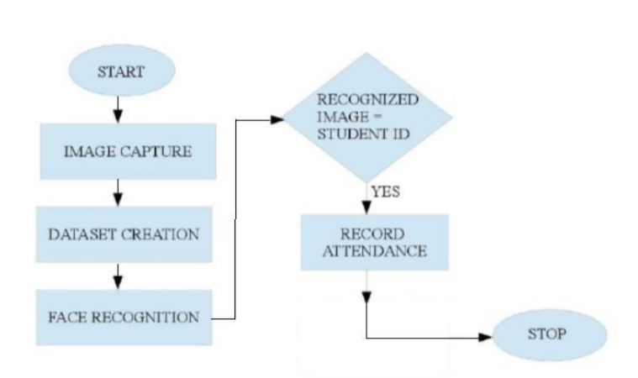
DESIGN AND WORKFLOW

Slide 7
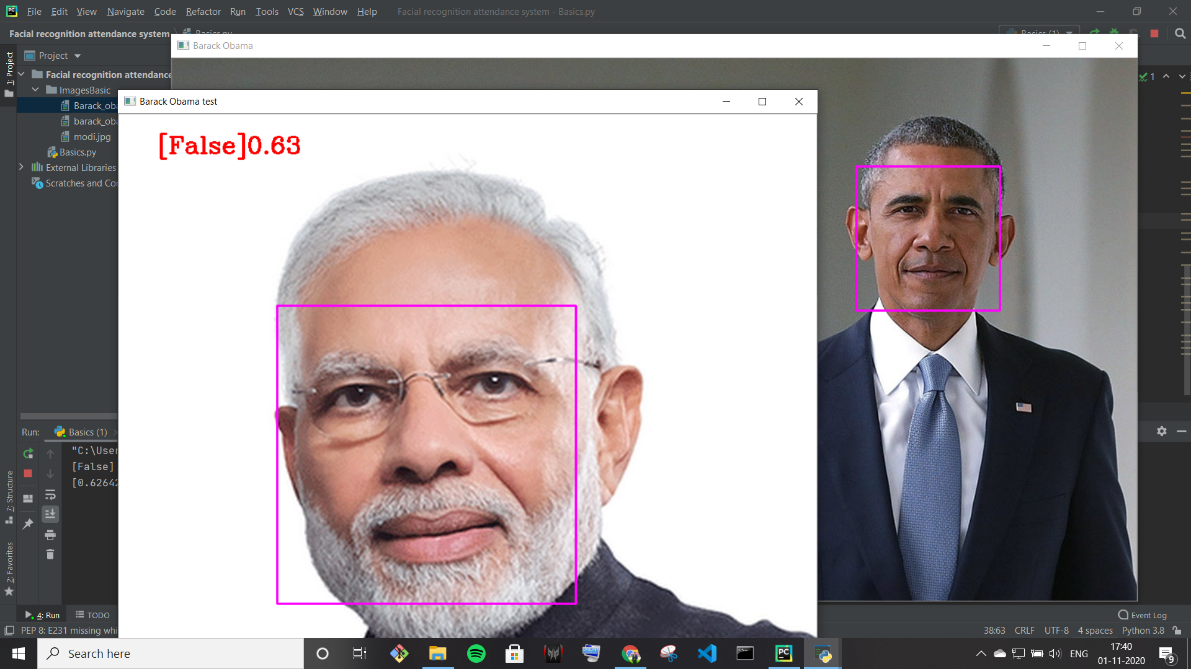
HOW DETECTION OF FACE AND IT’S CLASSIFICATION WORKS?

Slide 8
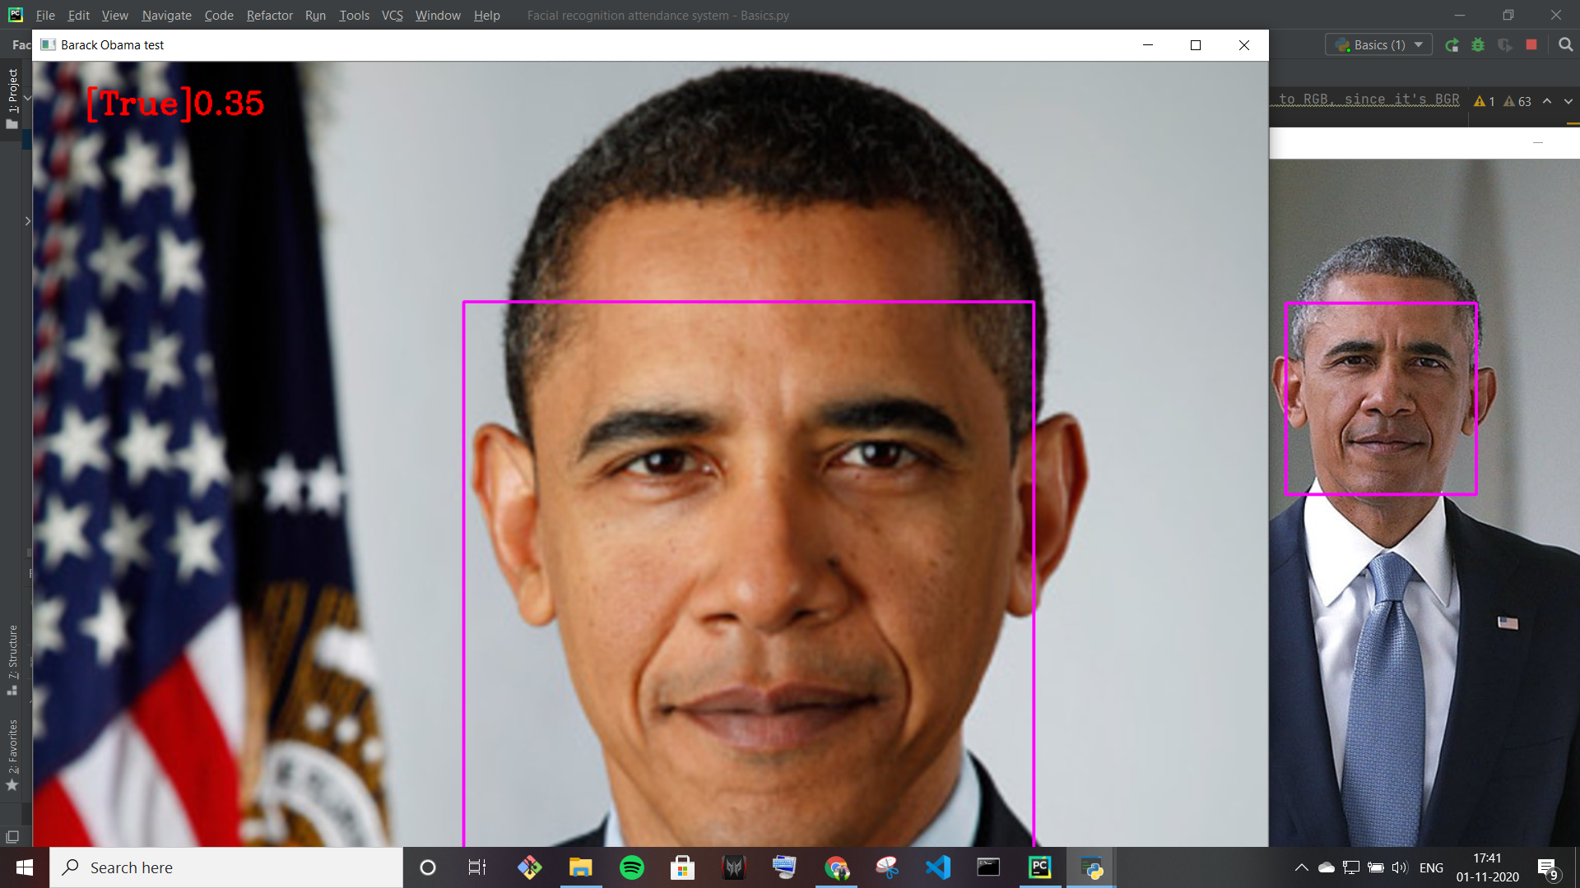
DOES IT RECOGNIZE ?

Slide 9
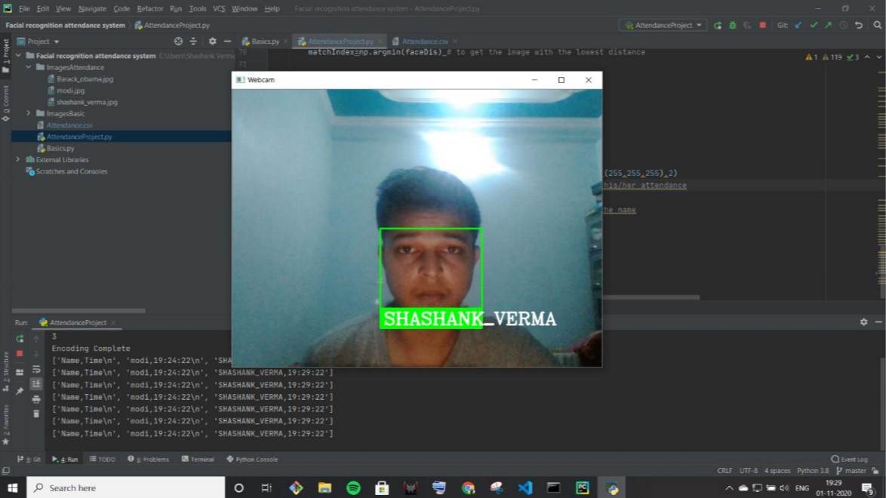
ORIGINAL WORKING SAMPLES

Slide 10
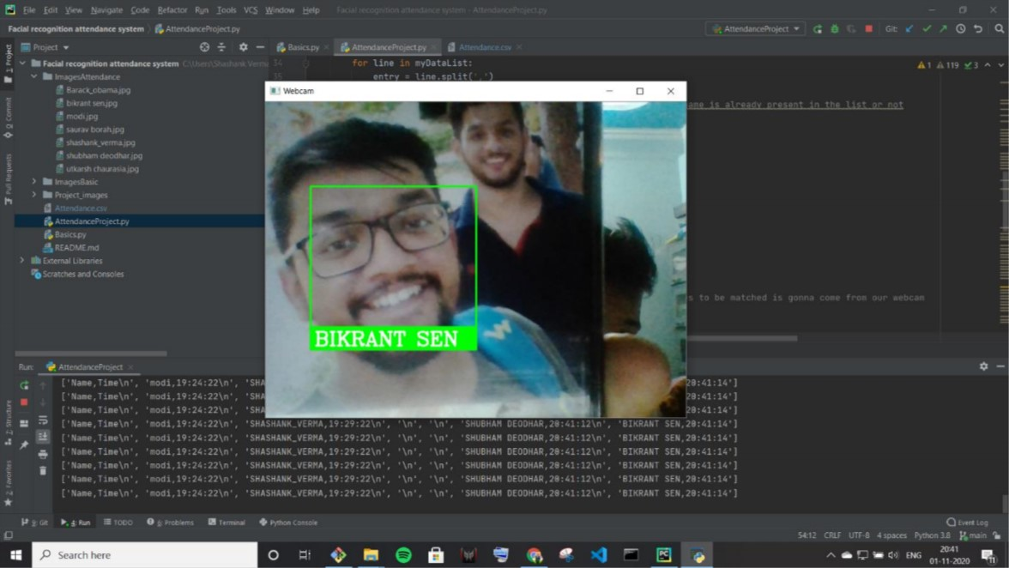

Slide 11
LIMITATIONS
Data privacy breach
Low reliability
Lack of regulations in the AI in Face recognition systems

Slide 12
SCOPE OF FACIAL RECOGNITION IN INDIA
Preventing the frauds at ATMs in India. A database of all customers with ATM cards in India can be created and facial recognition systems can be installed. So, whenever user will enter in ATM his photograph will be taken to permit the access after it is being matched with stored photo from the database.
Reporting duplicate voters in India.
Passport and visa verification can also be done using this technology.
driving license verification can be done using the same approach.
In defence ministry, airports, and all other important places the technology can be used to ensure better surveillance and security.
It can also be used during examinations such as Civil Services Exam, SSC, IIT, MBBS, and others to identify the candidates.
This system can be deployed for verification and attendance tracking at various government offices and corporates.
For access control verification and identification of authentic users it can also be installed in bank lockers and vaults.
For identification of criminals the system can be used by police force also.

Slide 13
CONCLUSION
Thus on completion of this project we have successfully made a FACIAL RECOGNITION ATTENDANCE SYSTEM which successfully detects faces and maps them into a .csv file. Thus this will enhance the attendance system and will ensure lesser errors and will in turn provide proper time management With the completion of this project we are extremely happy to have learnt the documentation and implementation of OpenCV and face-recognition libraries thus boosting the confidence to work in more projects related to it. It was indeed useful to have invested in this project as it taught us many new dependencies and also enabled us to be thorough with the Python implementation.

Slide 14
THANK YOU

